Slide 1

MACHINE LEARNING

Slide 2
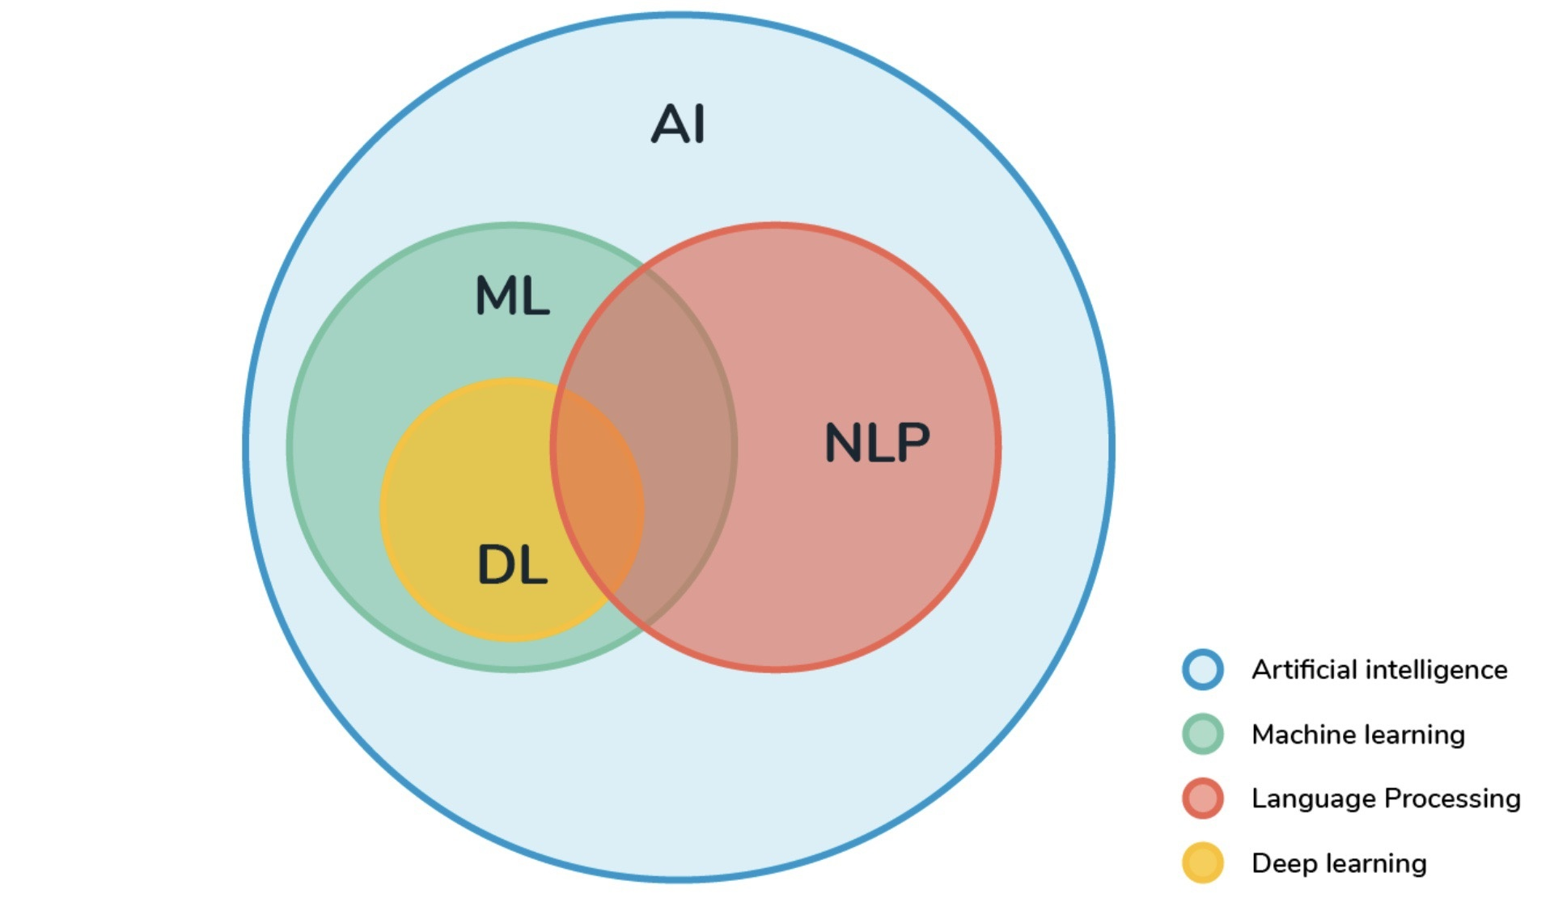

Slide 3
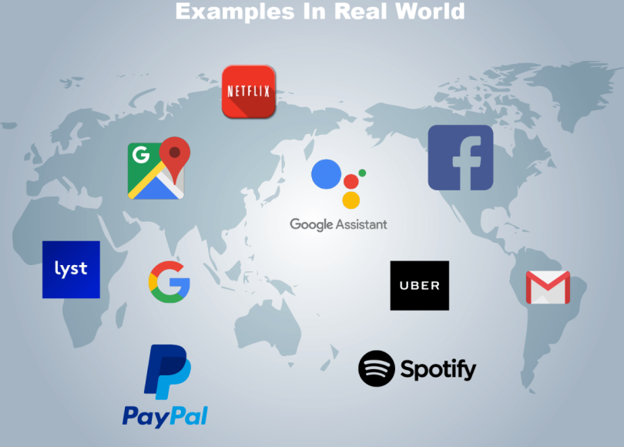

Slide 4
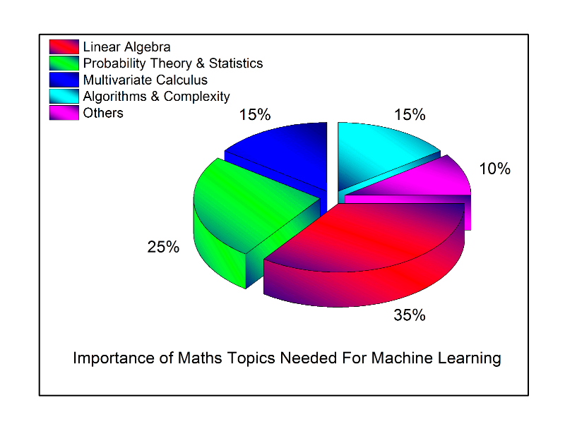
But…

Slide 5



Slide 6
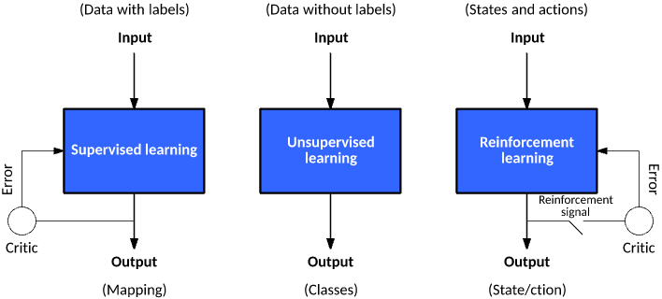
The 3 WAYS machine LEARN!

Slide 7


